Slide 1
A Harmony of Church, US, and World History

Slide 2
The Smith Family
Where and when was Joseph Smith, Jr. born?

Slide 3
The Smith Family
Where and when was Joseph Smith, Jr. born?
Sharon, Vermont
December 23, 1805

Slide 4
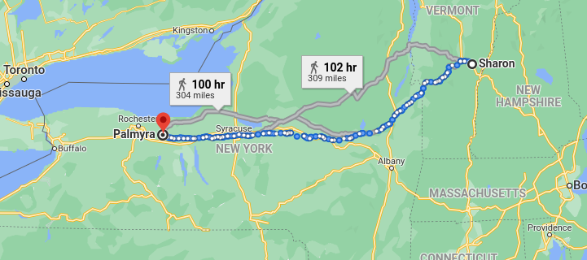
The Smith Family
In 1816-1817 the Smith Family moves to Palmyra, New York. WHY??

Slide 5
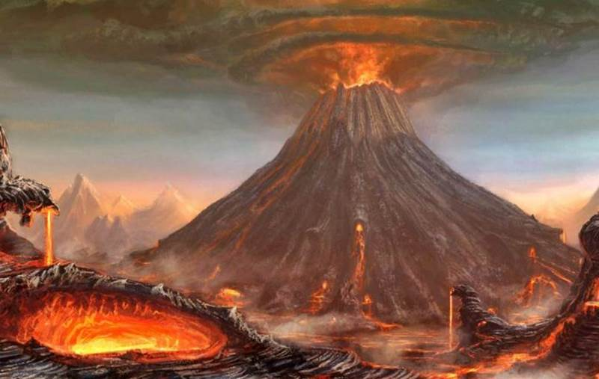
Mount Tambora

Slide 6
Mount Tambora Eruption
1815, April 5th through 11th. Minor explosions through July 15th.
Explosions heard as far away as 1600 miles away (people thought guns were firing)
24 cubic miles of rock ejected up to 27 miles high
Went from 14,100 ft to a 9,344 ft mountain
11,000 direct deaths; 71,000 more from starvation in the following months
The Tambora people wiped out, their language and culture gone

Slide 7
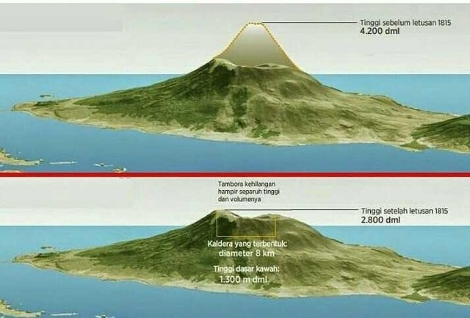
Mount Tambora

Slide 8
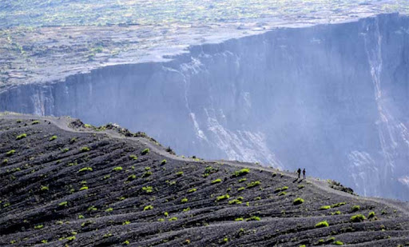
Mount Tambora

Slide 9
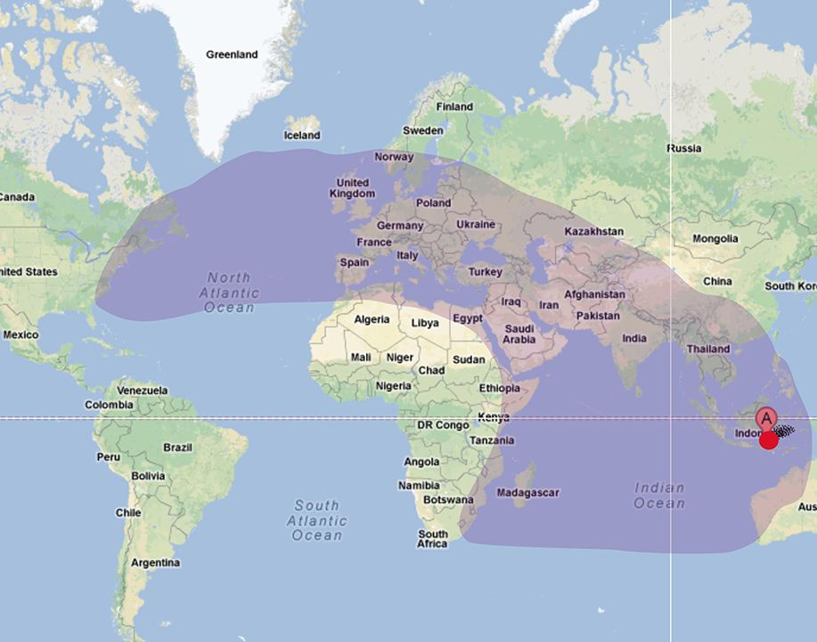
Mount Tambora

Slide 10
1776 to 1797
YEAR | CHURCH | USA | WORLD
1776 |  | Declaration of Independence | Adam Smith publishes The Wealth of Nations
1781 |  | Cornwall surrenders at Yorktown, VA
1787 |  | US Constitution written | Mozart premieres Don Giovanni
1789 |  | George Washington becomes president | Start of the French Revolution
1790 to 1840 |  | The Second Great Awakening
1794 |  | Ely Whitney patents the cotton gin, a 50x multiplier
1797 |  | John Adams becomes president

Slide 11
1798 to 1809
YEAR | CHURCH | USA | WORLD
1798 |  | Thomas Jefferson introduces a new plow
1801 |  | Thomas Jefferson
1802 |  |  | Beethoven performs his Moonlight Sonata
1803 |  | Louisiana Purchase from France, doubles size of US | Start of the Napoleonic Wars
1804 |  | Lewis and Clark Expedition begins in St. Louis
1805 | Joseph Smith born in Vermont
1809 |  | James Madison

Slide 12
1810 to 1817
YEAR | CHURCH | USA | WORLD
1810 |  | Population center of the US is 40 miles west of DC in Virginia
1812 |  | USA at war with Great Britain | Napoleon occupies Moscow
1813 |  |  | Jane Austen publishes Pride and Prejudice
1814 |  | British troops occupy DC Francis Scott Key pens The Star Spangled Banner | Russian troops occupy Paris Treaty of Ghent
1815 |  |  | Mount Tambora erupts in Indonesia
1816 to 1817 | Smith Family moves to NY
1817 |  | James Monroe

Slide 13
1817 to 1827
YEAR | CHURCH | USA | WORLD
1817 to 1825 |  | Construction of the Erie Canal Connects the Atlantic Ocean from NYC to the Great Lakes in Buffalo; cuts transport costs by 90%
1819 |  |  | John Keats writes his Odes of 1819
1820 | The First Vision | The Missouri Compromise Population center of US near Moorefield, WV
1823 | First Angel Moroni visit
1825 |  | John Quincy Adams First steam locomotive in the US
1827 | Joseph Smith and Emma hale marry Joseph obtains the Golden Plates

Slide 14
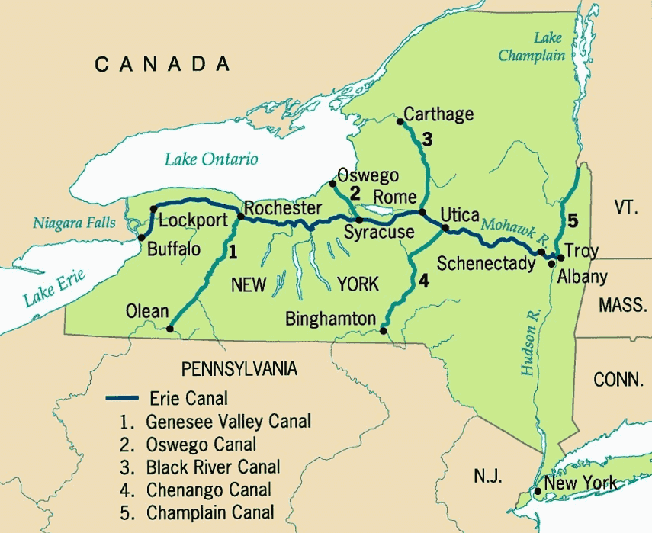
The Erie Canal

Slide 15
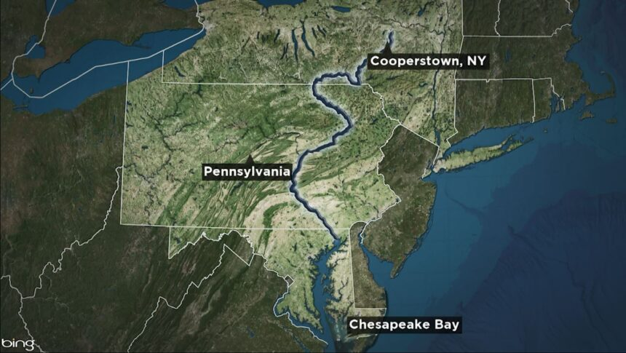
The Susquehanna River

Slide 16
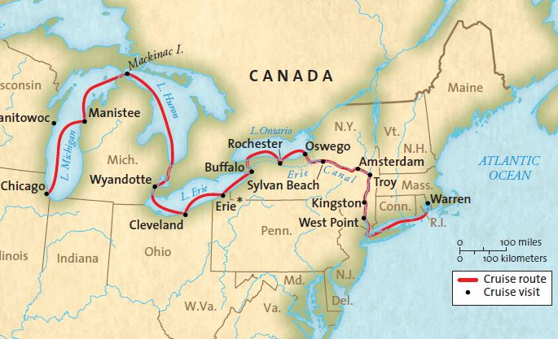
The Erie Canal and Great Lakes

Slide 17
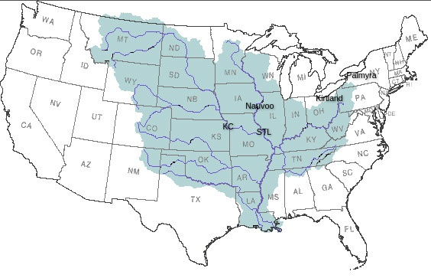
The Mississippi River Basin

Slide 18
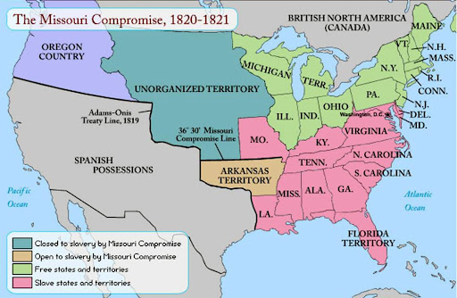
The Missouri Compromise

Slide 19
1829 to 1837
YEAR | CHURCH | USA | WORLD
1829 | Bulk of Book of Mormon translated Priesthood restored | Andrew Jackson
1830 | Church is founded
1831 | Smith moves to Ohio Revelation given that Missouri is the gathering place
1834 | Smith leads a militia to Missouri
1835 |  | PT Barnum begins his first circus tour
1836 | Kirtland temple built | Battle of the Alamo
1837 |  | Martin van Buren Telegraphy patented | Charles Dickens publishes Oliver Twist

Slide 20
1838 to 1840
YEAR | CHURCH | USA | WORLD
1838 | Smith relocates to Missouri Missouri “exterminates the Mormons” | 46,000 Native Americans forcibly relocated in the Trail of Tears
1839 | Smith relocates to Illinois
1840 |  | Population center of the US near Clarksburg, WV

